Slide 1




A Faster Exponential Time Algorithm for
Bin Packing with Constant Number of Bins
Jesper Nederlof
Jakub Pawlewicz
Céline Swennenhuis
Karol Węgrzycki
UU Warsaw TU/e Saarbrucken
Department of Mathematics and Computer Science, Eindhoven University of Technology

Slide 2
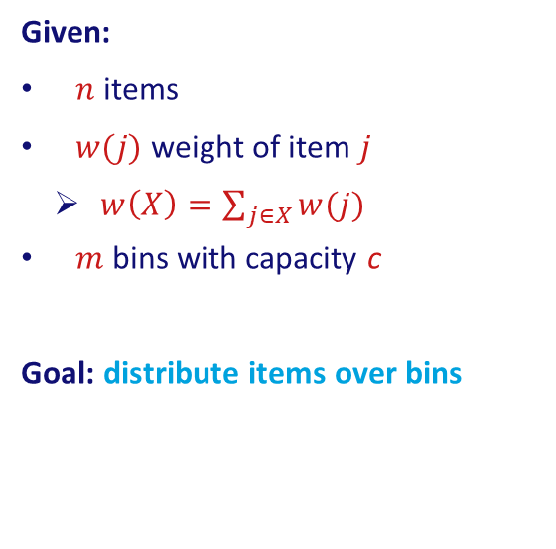
Bin Packing
5
4
2
1
Given:
$n$ items
$w(j)$ weight of item $j$
    $w\left(X\right)=\sum_{j∈X}{w(j)}$
$m$ bins with capacity c
Goal: distribute items over bins
3
3
1
4
5
4
8
8
8
8

Slide 3
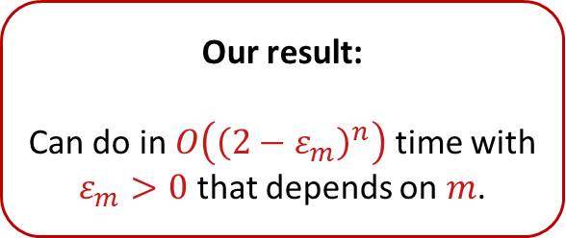



Bin Packing
Algorithm A
      Dynamic Programming
      $O\left(c^{m}⋅n\right)$
Algorithm B
      Björklund, Husfeldt and Koivisto (SICOMP 2009)
      $O\left(2^{n}⋅n\right)$
Our result:
Can do in $O\left({\left(2−ε_{m}\right)}^{n}\right)$ time with $ε_{m}>0$ that depends on $m$.
Open Question
Can do in $O\left({1.99999}^{n}\right)$ time?
Before our work, only known for $m=2,3$ (Lente et al.)

Slide 4

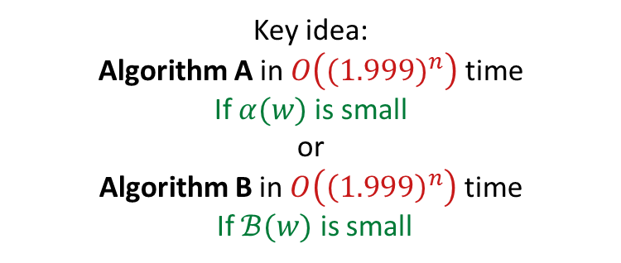
Bin Packing
$$α\left(w\right)=\left|\left\{w\left(X\right):X⊆\left[n\right]\right\}\right|$$
$$ℬ(w)=\left\{X:w\left(X\right)=s\right\}$$
Key idea:
Algorithm A in $O\left({(1.999)}^{n}\right)$ time
If $α(w)$ is small
or
Algorithm B in $O\left({\left(1.999\right)}^{n}\right)$ time
If $ℬ(w)$ is small
Algorithm A
      Dynamic Programming
      $O\left(c^{m}⋅n\right)$
Algorithm B
      Björklund, Husfeldt and Koivisto (SICOMP 2009)
      $O\left(2^{n}⋅n\right)$
Our result:
Can do in $O\left({\left(2−ε_{m}\right)}^{n}\right)$ time with $ε_{m}>0$ that depends on $m$.
Open Question
Can do in $O\left({1.99999}^{n}\right)$ time?
Before our work, only known for $m=2,3$ (Lente et al.)

Slide 5
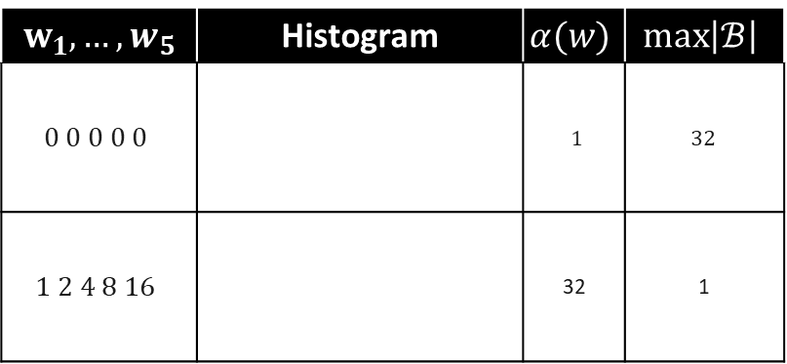
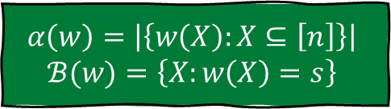
Parameters $α(w)$ and $|𝓑|$
$$α\left(w\right)=\left|\left\{w\left(X\right):X⊆\left[n\right]\right\}\right|$$
$$ℬ(w)=\left\{X:w\left(X\right)=s\right\}$$
$$w_{1},…,w_{5}$$ | Histogram | $$α(w)$$ | $$\max\left|ℬ\right|$$
$$0 0 0 0 0$$ |  | $1$ | $$32$$
$$1 2 4 8 16$$ |  | 32 | 1

Slide 6
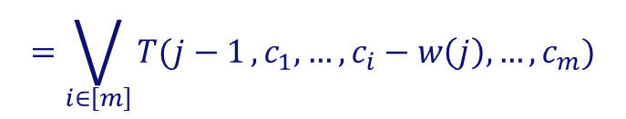
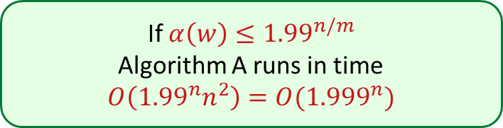



Algorithm A:
If $α\left(w\right)≤1.99^{n/m}$
Algorithm A runs in time
$$O\left({1.99}^{n}n^{2}\right)=O({1.999}^{n})$$
$$=\bigvee_{i∈\left[m\right]}{T(j−1},c_{1},…,c_{i}−w\left(j\right),…,c_{m})$$
$$T\left(j,c_{1},c_{2},…, c_{m}\right)$$
Items $1,…,j$
leftover capacities
Runtime: $O\left(c^{m}⋅n^{2}\right)$
$$α\left(w\right)=\left|\left\{w\left(X\right):X⊆\left[n\right]\right\}\right|$$
New runtime: $O\left({α(w)}^{m}⋅n^{2}\right)$

Slide 7

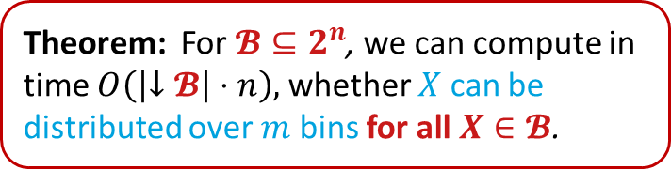
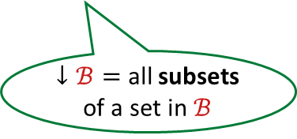
Algorithm B:
Theorem: For $𝓑⊆2^{n}$, we can compute in time $O\left(\left|↓𝓑\right|⋅n\right),$ whether $X$ can be distributed over $m$ bins for all $X∈𝓑$.
$↓ℬ=$ all subsets of a set in $ℬ$
Based on:
Inclusion/Exclusion
Fast algebraic transformations (Zeta/Möbius)
$$ℬ=\{X_{1},X_{2},X_{3},…\}$$
Yes!
Yes!
No!

Slide 8



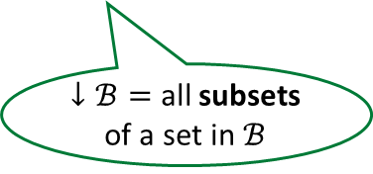

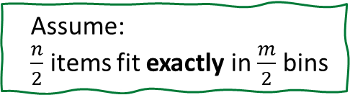

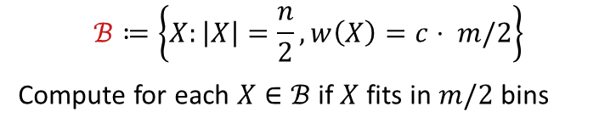

Algorithm B:
Theorem: For $𝓑⊆2^{n}$, we can compute in time $O\left(\left|↓𝓑\right|⋅n\right),$ whether $X$ can be distributed over $m$ bins for all $X∈𝓑$.
Assume:
$\frac{n}{2}$ items fit exactly in $\frac{m}{2}$ bins
$$ℬ≔\left\{X:\left|X\right|=\frac{n}{2}, w\left(X\right)=c⋅ m/2\right\}$$
Compute for each $X∈ℬ$ if $X$ fits in $m/2$ bins
$↓ℬ=$ all subsets of a set in $ℬ$
$$O(\left|↓ℬ\right|⋅n)$$
$$m/2$$
$$m/2$$
$\left|ℬ\right|≤\left|\left\{X:w\left(X\right)=c⋅\frac{m}{2}\right\}\right|≤$ $\left|ℬ(w)\right|$
$$X$$
$$\left[n\right]∖X$$
Yes!
Yes!

Slide 9

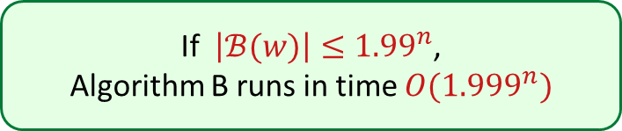
Algorithm B:
If $\left|ℬ(w)\right|≤{1.99}^{n}$,
Algorithm B runs in time $O({1.999}^{n})$
Theorem: For $𝓑⊆2^{n}$, we can compute in time $O\left(\left|↓𝓑\right|⋅n\right),$ whether $X$ can be distributed over $m$ bins for all $X∈𝓑$.
Assume:
$\frac{n}{2}$ items fit exactly in $\frac{m}{2}$ bins
$$ℬ≔\left\{X:\left|X\right|=\frac{n}{2}, w\left(X\right)=c⋅ m/2\right\}$$
Compute for each $X∈ℬ$ if $X$ fits in $m/2$ bins
$↓ℬ=$ all subsets of a set in $ℬ$
$$O(\left|↓ℬ\right|⋅n)$$
$$m/2$$
$$m/2$$
$$\left|ℬ\right|≤{1.99}^{n}⇒\left|↓ℬ\right|≤{1.999}^{n}$$
$\left|ℬ\right|≤\left|\left\{X:w\left(X\right)=c⋅\frac{m}{2}\right\}\right|≤$ $\left|ℬ(w)\right|$
$$X$$
$$\left[n\right]∖X$$
Yes!
Yes!

Slide 10
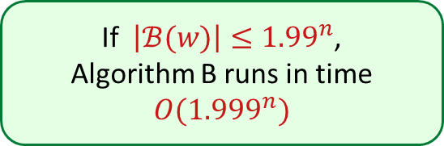
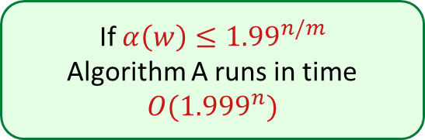
Additive Combinatorics
$$α\left(w\right)=\left|\left\{w\left(X\right):X⊆\left[n\right]\right\}\right|$$
$$ℬ(w)=\left\{X:w\left(X\right)=s\right\}$$
If $α\left(w\right)≤1.99^{n/m}$
Algorithm A runs in time $O({1.999}^{n})$
If $\left|ℬ(w)\right|≤{1.99}^{n}$,
Algorithm B runs in time $O({1.999}^{n})$

Slide 11
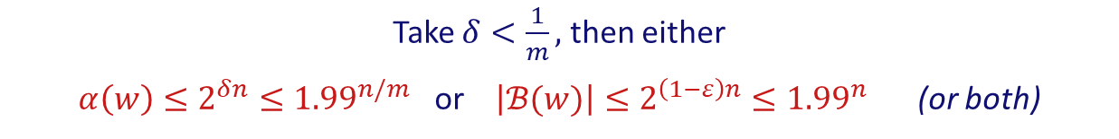

Additive Combinatorics
$$α\left(w\right)=\left|\left\{w\left(X\right):X⊆\left[n\right]\right\}\right|$$
$$ℬ(w)=\left\{X:w\left(X\right)=s\right\}$$
If $α\left(w\right)≤1.99^{n/m}$
Algorithm A runs in time $O({1.999}^{n})$
If $\left|ℬ(w)\right|≤{1.99}^{n}$,
Algorithm B runs in time $O({1.999}^{n})$
Theorem: For all $δ>0$ there exists $ε>0$ s.t.
if $α(w)≥2^{δn}$, then $\left|ℬ(w)\right|≤2^{\left(1−ε\right)n}$.
How to prove this?
Take $δ<\frac{1}{m},$ then either
$α\left(w\right)≤2^{δn}≤{1.99}^{n/m}$ or $\left|ℬ(w)\right|≤2^{\left(1−ε\right)n}≤{1.99}^{n}$ (or both)

Slide 12
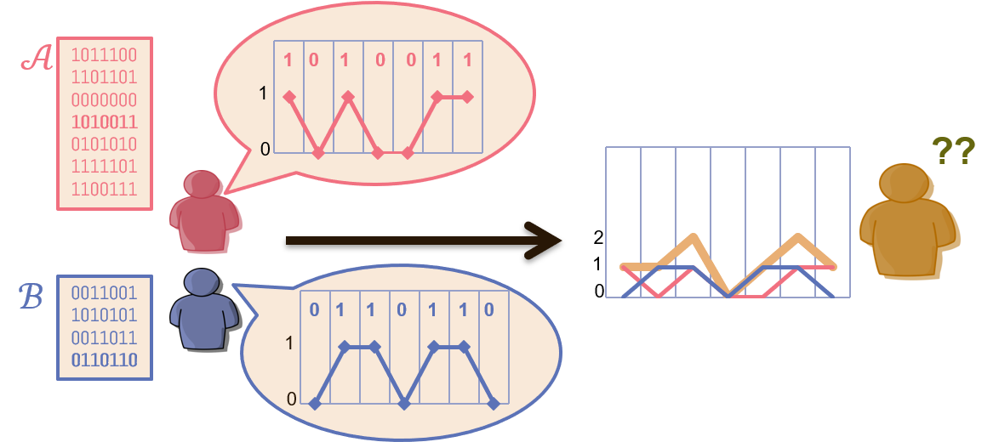

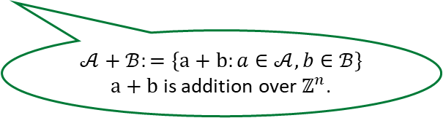
Additive Combinatorics
Def: Uniquely Decodable Pairs (UDCP’s)
A UDCP is a pair $𝒜,ℬ⊆\{0,1\}^{n}$ s.t. $\left|𝒜+ℬ\right|=\left|𝒜\right||ℬ|$.
$$𝒜+ℬ:=\{a+b:a∈𝒜, b∈ℬ\}$$
$a+b$ is addition over $ℤ^{n}$.

Slide 13




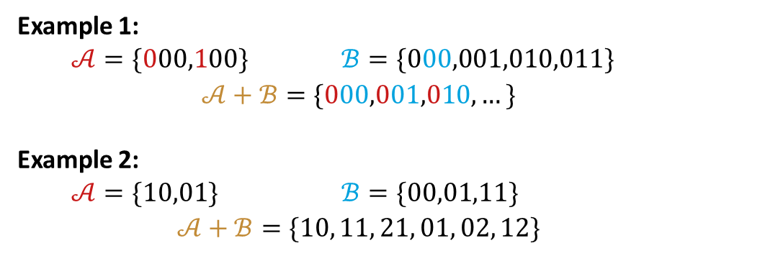
Additive Combinatorics
Def: Uniquely Decodable Pairs (UDCP’s)
A UDCP is a pair $𝒜,ℬ⊆\{0,1\}^{n}$ s.t. $\left|𝒜+ℬ\right|=\left|𝒜\right||ℬ|$.
$$𝒜+ℬ:=\{a+b:a∈𝒜, b∈ℬ\}$$
$a+b$ is addition over $ℤ^{n}$.
Example 1:
  $𝒜=\{000,100\}$ $ℬ=\{000,001,010,011\}$
  $$𝒜+ℬ=\{000,001,010,…\}$$
Example 2:
  $𝒜=\{10,01\}$ $ℬ=\{00,01,11\}$
  $$𝒜+ℬ=\{10, 11, 21, 01, 02, 12\}$$

Slide 14
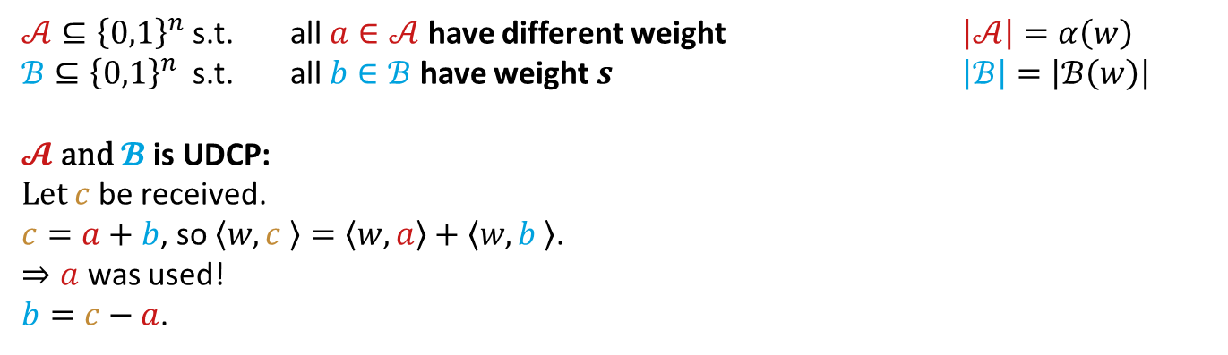

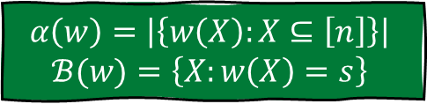
Additive Combinatorics
$$α\left(w\right)=\left|\left\{w\left(X\right):X⊆\left[n\right]\right\}\right|$$
$$ℬ(w)=\left\{X:w\left(X\right)=s\right\}$$
Def: Uniquely Decodable Pairs (UDCP’s)
A UDCP is a pair $𝒜,ℬ⊆\{0,1\}^{n}$ s.t. $\left|𝒜+ℬ\right|=\left|𝒜\right||ℬ|$.
$𝒜⊆{\left\{0,1\right\}}^{n}$ s.t. all $a∈𝒜$ have different weight $\left|𝒜\right|=α\left(w\right)$
$ℬ⊆{\left\{0,1\right\}}^{n}$ s.t. all $b∈ℬ$ have weight $s$ $\left|ℬ\right|=\left|ℬ\left(w\right)\right|$
$$𝓐 \text{and} 𝓑 \text{is} \text{UDCP}\text{:}$$
Let $c$ be received.
$c=a+b$, so $\left\langle w,c \right\rangle =\left\langle w,a\right\rangle +\left\langle w,b \right\rangle$.
$⇒a$ was used!
$b=c−a$.
See $w$ as a vector,
$$w\left(X\right)= \left\langle w,X\right\rangle =\left\langle \begin{matrix}w(1) \\ w(2) \\ w(3) \\ ⋮ \\ w(n)\end{matrix},\begin{matrix}0 \\ 1 \\ 0 \\ ⋮ \\ 1\end{matrix} \right\rangle$$

Slide 15
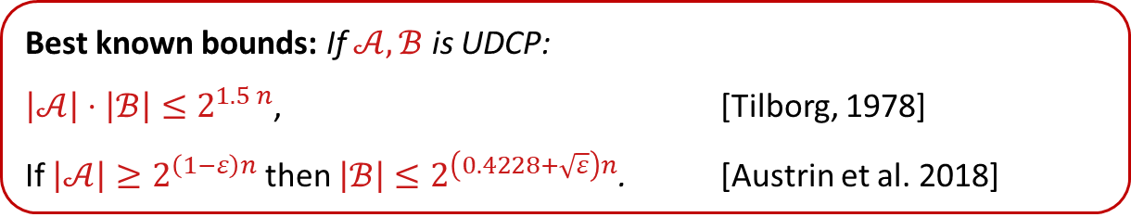
Additive Combinatorics
Def: Uniquely Decodable Pairs (UDCP’s)
A UDCP is a pair $𝒜,ℬ⊆\{0,1\}^{n}$ s.t. $\left|𝒜+ℬ\right|=\left|𝒜\right||ℬ|$.
Best known bounds: If $𝒜,ℬ$ is UDCP:
$\left|𝒜\right|⋅\left|ℬ\right|≤2^{1.5 n}$, [Tilborg, 1978]
If $\left|𝒜\right|≥2^{\left(1−ε\right)n}$ then $\left|ℬ\right|≤2^{\left(0.4228+\sqrt{ε}\right)n}$. [Austrin et al. 2018]
We need: If $\left|𝒜\right|≥2^{δn}$, then $\left|ℬ\right|≤2^{\left(1−ε\right)n}$.

Slide 16

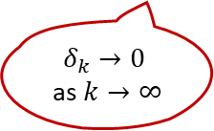
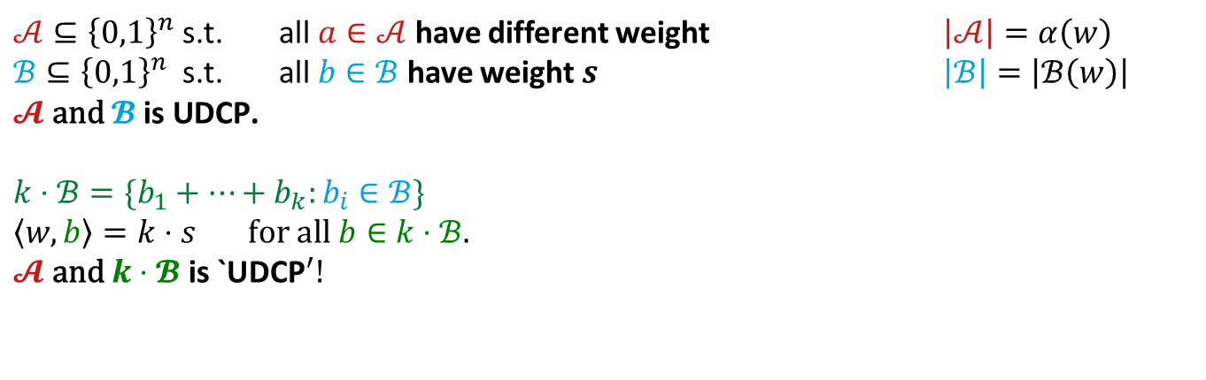


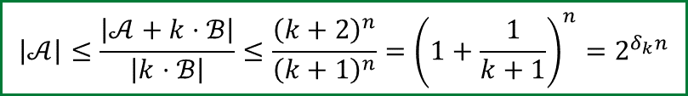
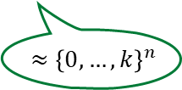
Additive Combinatorics
$$α\left(w\right)=\left|\left\{w\left(X\right):X⊆\left[n\right]\right\}\right|$$
$$ℬ(w)=\left\{X:w\left(X\right)=s\right\}$$
Def: Uniquely Decodable Pairs (UDCP’s)
A UDCP is a pair $𝒜,ℬ⊆\{0,1\}^{n}$ s.t. $\left|𝒜+ℬ\right|=\left|𝒜\right||ℬ|$.
$𝒜⊆{\left\{0,1\right\}}^{n}$ s.t. all $a∈𝒜$ have different weight $\left|𝒜\right|=α\left(w\right)$
$ℬ⊆{\left\{0,1\right\}}^{n}$ s.t. all $b∈ℬ$ have weight $s$ $\left|ℬ\right|=\left|ℬ\left(w\right)\right|$
$$𝓐 \text{and} 𝓑 \text{is} \text{UDCP}\text{.}$$
$k⋅ℬ=\{b_{1}+…+b_{k}:b_{i}∈ℬ\}$
$\left\langle w,b\right\rangle =k⋅s$ for all $b∈k⋅ℬ$.
$$𝓐 \text{and} k⋅𝓑 \text{is} {\text{`}\text{UDCP}}^{′}!$$
$$⊆{\left\{0,…,k+1\right\}}^{n}$$
$$\left|𝒜\right|≤\frac{\left|𝒜+k⋅ℬ\right|}{\left|k⋅ℬ\right|}≤\frac{{\left(k+2\right)}^{n}}{{\left(k+1\right)}^{n}}={\left(1+\frac{1}{k+1}\right)}^{n}=2^{δ_{k}n}$$
${≈\left\{0,…,k\right\}}^{n}$
$δ_{k}→0$ as $k→∞$
Assume $ℬ≈{\left\{0,1\right\}}^{n}$

Slide 17
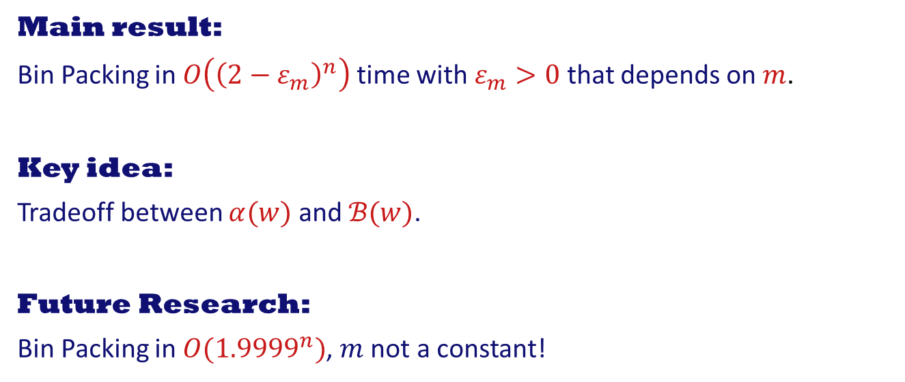
Conclusion
Main result:
Bin Packing in $O\left({\left(2−ε_{m}\right)}^{n}\right)$ time with $ε_{m}>0$ that depends on $m$.
Key idea:
Tradeoff between $α(w)$ and $ℬ(w)$.
Future Research:
Bin Packing in $O({1.9999}^{n})$, $m$ not a constant!

